Slide 1


AI PROJECT MANAGEMENT, INCEPTION AND PLANNING

Slide 2
MODULE AGENDA

Slide 3

Module Agenda
Defining AI Project Vision
Performing a Feasibility assessment & defining the Scope
AI Project Metrics – Model, System, & Business
Defining SMART Goals
Key Stakeholders, Roles and Responsibilities in AI Projects
Differences between Agile and Waterfall development
Scaled Agile Framework (SAFe)
Key Success Ingredients for AI Projects
Risks and Management Strategies
Budgeting and resource allocation
© All rights reserved for Dr. Ryan Ahmed @Stemplicity Inc.

Slide 4
Step 1. Problem Scoping
Define the business problem & objectives. Use the 4Ws (Who, What, Where, Why) to understand context & expected outcomes.
Step 3. Data Exploration
Analyze the data to understand patterns, identify outliers, handle missing values, & perform feature engineering.
Step 2. Data Acquisition
Gather relevant data from internal and/or external sources. This includes structured & unstructured data collection through APIs, databases, sensors, etc.
Step 4. Modeling
Develop & train AI models using selected algorithms. Fine-tune the model to improve accuracy & performance.
Step 5. Model Evaluation
Assess model performance using metrics such as accuracy, precision, recall, F1-score, etc. This helps ensure the model is reliable and generalizable.
Step 6. Deployment
Integrate the trained model into a production environment where it can be used by end users to generate predictions.
Step 7. Maintenance & Monitoring
Continuously monitor the model’s performance and retrain it as needed to ensure it adapts to new data and remains effective over time.
Recall the AI Project lifecycle
Our focus
© All rights reserved for Dr. Ryan Ahmed @Stemplicity Inc.

Slide 5
DEFINING VISION, SCOPE & FEASIBILITY ASSESSMENT

Slide 6
Introduction to Managing AI Projects
In this module, we will focus on project management fundamentals as they apply to AI projects.
Successfully delivering an AI project is not just about algorithms and models; it requires careful planning, coordination, and alignment with business goals.
Planning: Define scope, success metrics, and timelines.
Coordination: Cross-functional communication and agile teams.
Business Alignment: Ensure ROI, KPIs, and stakeholder buy-in.
Planning
Coordination
Business Alignment
© All rights reserved for Dr. Ryan Ahmed @Stemplicity Inc.

Slide 7

Defining AI Project Vision: Your "North Star"
What does success look like? Clearly articulate the desired end-state.
How will this AI initiative fundamentally improve or transform a part of the business?
A strong vision guides all subsequent decisions and keeps the team focused.
© All rights reserved for Dr. Ryan Ahmed @Stemplicity Inc.

Slide 8
Business Value Assessment: Why this Project?
Before deploying resources to any AI project, the first step is to ensure strategic alignment and measurable impact by answering a key question: Why this project?
Leadership should clearly identify the following key pillars:
Quantify Expected Business Value: Estimate potential outcomes such as cost reduction (e.g., 15%), revenue growth (e.g., $1M annually), or time savings (e.g., 3,000 labor hours per year).
Align with Strategic Goals: Ensure the project directly supports key business objectives such as improving customer retention, increasing operational efficiency, or unlocking new revenue streams.
Define Clear Success Metrics: Establish well-defined Key Performance Indicators (KPIs) to track performance and ROI.
© All rights reserved for Dr. Ryan Ahmed @Stemplicity Inc.

Slide 9
Feasibility Assessment: Can We Deliver This AI Project?
Before moving forward, leadership must assess whether the AI project is feasible from technical, organizational, and data perspectives.
Technical Feasibility: Do we have the right tools and infrastructure (e.g., cloud, compute)?, Are the required AI models technically achievable given our use case?
Organizational Readiness: Do we have skilled personnel (data scientists, ML engineers)?
Data Availability & Quality: Do we have access to the right data (historical, real-time, labeled)?, Is the data clean, complete, & enough to train a model?
Cost & Resource Constraints: Can we deliver the project within the available budget and timeframe?, Are there tools we can leverage to reduce development costs (e.g., AutoML, pre-trained models)?
© All rights reserved for Dr. Ryan Ahmed @Stemplicity Inc.

Slide 10

Defining AI Project Scope
It is critical to outline what the project will and will not deliver to manage expectations and avoid scope creep.
Adopt a Minimum Viable Product (MVP) approach, focusing first on delivering core functionality that demonstrates value.
As data understanding and insights evolve, revisit and validate the scope to ensure continued alignment with project goals and stakeholder needs.
Example: Self-Driving Car MVP
In Scope (MVP – Highway Driving)
Lane keeping on highways
Adaptive cruise control
Automatic lane changes in clear conditions
Operating in daylight and good weather
Out of Scope (Future Phases):
Urban driving (e.g., traffic lights, pedestrians, intersections)
Complex weather conditions (e.g., snow, heavy rain, fog)
Construction zones and unstructured environments
Nighttime driving with limited visibility
© All rights reserved for Dr. Ryan Ahmed @Stemplicity Inc.

Slide 11
PRACTICE OPPORTUNITY

Slide 12

Practice Opportunity
Background
UnitedHealth Group is one of the largest health insurance providers in North America. The company processes over 10 million claims yearly, with rising concerns about fraudulent activity, especially in dental and outpatient claims. Leadership wants to implement an AI model to automatically flag potentially fraudulent claims for human review, helping reduce unnecessary payouts and speed up claims processing.
The data science team at UnitedHealth Group is small (2 data analysts and 1 software engineer), but the company has budgeted for hiring one external AI consultant to support the MVP phase. UnitedHealth Group already stores its claims data in a cloud database (BigQuery) and uses Google Cloud tools like AutoML and Vertex AI for analytics. Historical claim data includes structured fields such as: Type of procedure, Date of service, Claimed amount, Provider ID, and Region. The leadership team aims to launch a prototype in 6 months, starting with the most frequent and least complex claims.
You are part of a team tasked with evaluating the feasibility of this AI project and defining its initial scope before the company invests resources.
Your Tasks
Assess whether the project is technically and organizationally feasible.
Define what the AI system should focus on in its first version (MVP) and what should be left for future phases.
© All rights reserved for Dr. Ryan Ahmed @Stemplicity Inc.

Slide 13
Practice Opportunity Solution
Pillar | Feasible? | Reasoning
Technical Feasibility | Yes | UnitedHealth Group uses Google Cloud, BigQuery, and AutoML; sufficient for building a fraud detection prototype using structured data.
Organizational Readiness | Partially | The internal team is small, but support from an external AI consultant makes an MVP feasible. More hiring would be needed for full deployment.
Data Availability & Quality | Yes | The company has labeled historical structured data (procedure code, amount, approval outcome), which is clean and stored in a modern cloud system.
Cost & Resource Constraints | Yes | The project is scoped to 6 months, leveraging existing tools (AutoML) and an external consultant. This is realistic for a Phase 1 MVP.
© All rights reserved for Dr. Ryan Ahmed @Stemplicity Inc.

Slide 14
Practice Opportunity Solution
In Scope (Phase 1 - MVP) | Out of Scope (Future Phases)
Focus on dental and outpatient claims | Complex claims such as surgical
Use only structured data (e.g., procedure code, cost) | No use of scanned documents or unstructured notes
Model flags suspicious claims for manual review only | No autonomous approvals or rejections of claims
Leverage AutoML for model development | No custom model building experimentation
Weekly batch predictions for claims | No real-time scoring or streaming data integration
© All rights reserved for Dr. Ryan Ahmed @Stemplicity Inc.

Slide 15
AI PROJECT SUCCESS METRICS: MODEL, SYSTEM, & BUSINESS

Slide 16
AI Projects SMART Goals
In AI projects, success metrics should follow the SMART criteria and be aligned with business, system, and model-level goals.
Specific
Measurable
Achievable
Relevant
Time-Bound
© All rights reserved for Dr. Ryan Ahmed @Stemplicity Inc.

Slide 17
Example
Goal: Reduce average customer service response time by 40% (from 5 minutes to 3 minutes) by deploying an AI-powered chatbot within 3 months, while maintaining a customer satisfaction score above 85%.
SMART Criterion | Explanation
Specific | Focused on reducing response time using a chatbot.
Measurable | 40% reduction in response time and customer satisfaction score ≥ 85%.
Achievable | Based on industry benchmarks and current capacity.
Relevant | Aligns with business goals: improving user experience and reducing support costs.
Time-bound | Deadline set to 3 months.
© All rights reserved for Dr. Ryan Ahmed @Stemplicity Inc.

Slide 18
Three Levels of AI Success Metrics: Model, System, Business
Model Quality Metrics
System Quality Metrics
Business Metrics
Model Quality Metrics measure what your model produces.
For traditional classification models: accuracy, Precision, Recall.
For LLMs, could be coherence, instruction adherence, etc.
System Quality Metrics measure how well the model runs, such as deployment, reliability, latency, throughput, and resource efficiency.
These measure the real-world business impact of your AI system.
Assesses productivity gains, cost savings, and customer experience improvements.
Helps justify AI investments and prioritize high-impact use cases.
© All rights reserved for Dr. Ryan Ahmed @Stemplicity Inc.

Slide 19
Success Metrics Examples
Business: Increase customer retention by 15% in the next 6 months using AI-driven product recommendations, while maintaining customer satisfaction above 90%.
Model: Achieve a minimum F1 score of 0.92 on the test dataset within 4 weeks of training, using cross-validation and hyperparameter tuning.
© All rights reserved for Dr. Ryan Ahmed @Stemplicity Inc.
System: Maintain 99.9% uptime and ensure API response latency stays under 250ms for 95% of user requests over the next 3 months post-deployment.

Slide 20
PRACTICE OPPORTUNITY

Slide 21
Practice Opportunity
A bank wants to use AI to predict which customers are likely to miss their monthly loan payments. The goal is to help customer service teams proactively reach out and offer help before a payment is missed.
Your team has been tasked to build the AI system, and you’ve been asked to define how success will be measured at three levels: model, system, and business. List 3 models, business, and system metrics in SMART goal format.
© All rights reserved for Dr. Ryan Ahmed @Stemplicity Inc.

Slide 22
Practice Opportunity Solution
Category | Metric | SMART Goal
Model | Correct Prediction Rate | Achieve at least 85% accuracy in predicting missed payments within 3 months.
 | False Positive Rate | Keep incorrect warnings under 10% during the pilot phase.
 | False Negative Rate | Identify at least 90% of truly risky customers by the end of Q2.
System | Response Time | Ensure results are returned in under 2 seconds for 95% of users by launch.
 | System Uptime | Maintain 99.5% uptime during business hours in the first 60 days.
 | Scalability | Support 1000 predictions/hour without slowdown by end of first month.
Business | Missed Payment Reduction | Reduce missed loan payments by 12% within 3 months of system use.
 | Proactive Outreach Rate | Increase early outreach calls by 25% in the first month after deployment.
 | Cost Savings | Achieve a 10% reduction in payment collection costs within 6 months.
© All rights reserved for Dr. Ryan Ahmed @Stemplicity Inc.

Slide 23
KEY AI PROJECTS STAKEHOLDERS AND ROLES

Slide 24
Key Roles in AI Projects
1. Business & Product Roles
2. Data Science & AI Roles
3. Development & Operations Roles
4. Data Engineering Roles
© All rights reserved for Dr. Ryan Ahmed @Stemplicity Inc.

Slide 25
Summary
Role | Key Responsibilities
AI Product Manager | Bridges technical and business teams; defines vision, translates problems, sets metrics
Industry Domain Expert | Provides subject matter expertise, validates data and features
Project Manager | Coordinates project scope, timelines, communication, and risk
AI Researcher | Explores novel models and learning techniques
Data Scientist | Analyzes data, builds models, extracts insights
Machine Learning Engineer | Builds scalable ML pipelines, deploys models
Responsible AI / Ethics Lead | Audits models for fairness, ethics, and bias
UX Designer | Designs intuitive AI interfaces and feedback loops
Software Engineer | Develops applications integrating AI models
Solution Architect | Designs system architecture and integration plan
MLOps Architect | Manages deployment, monitoring, and updates
Data Engineer | Builds ETL pipelines, structures and cleans data
Data Architect | Designs data infrastructure, governance policies
© All rights reserved for Dr. Ryan Ahmed @Stemplicity Inc.

Slide 26
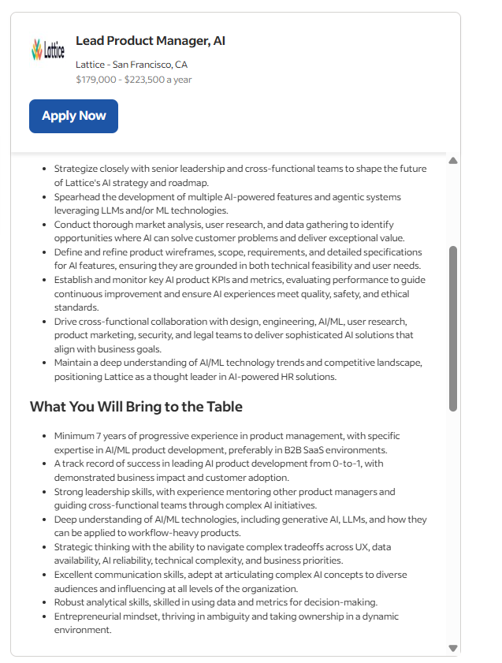
1. Business and Product Roles: AI Product Manager
Role Description:
Bridges the gap between the technical team and business stakeholders. They must understand AI-specific trade-offs (e.g., accuracy vs interpretability) and feasibility.
Key Responsibilities:
Define the AI product vision & roadmap.
Translate business problems into machine learning objectives.
Work closely with data scientists, engineers, and UX teams.
Define success metrics (e.g., model & business KPIs).
Prioritize features based on user feedback, risk, and impact.
Why It’s Critical:
AI initiatives often fail due to poor alignment with business goals; this role ensures the AI solution solves a real, measurable problem.
© All rights reserved for Dr. Ryan Ahmed @Stemplicity Inc.
https://www.indeed.com/cmp/Lattice-6/jobs?jk=5e803e3e68aeb306&start=0

Slide 27
1. Business and Product Roles: Industry Domain Expert
Role Summary:
Provides the real-world context and subject matter expertise.
Key Responsibilities:
Explain domain-specific details to the technical team (e.g., healthcare codes, financial regulations).
Validate data relevance and feature engineering.
Provide data labelling criteria & analyze model outputs in a business context.
Why It’s Critical:
AI models trained without domain context can make misleading or even dangerous predictions (e.g., in finance, healthcare). Domain expertise ensures relevance and accuracy.
© All rights reserved for Dr. Ryan Ahmed @Stemplicity Inc.

Slide 28
1. Business and Product Roles: Project Manager
Role Summary:
Coordinates all moving parts of an AI project to ensure it is delivered on time, within scope, and on budget.
Key Responsibilities:
Create and manage the project plan.
Track milestones and deliverables.
Facilitate communication across cross-functional teams.
Mitigate risks, manage dependencies, and ensure resource availability and allocation.
Why It’s Critical:
AI projects often span across departments and involve iterative development. A project manager keeps the team focused and aligned.
© All rights reserved for Dr. Ryan Ahmed @Stemplicity Inc.

Slide 29
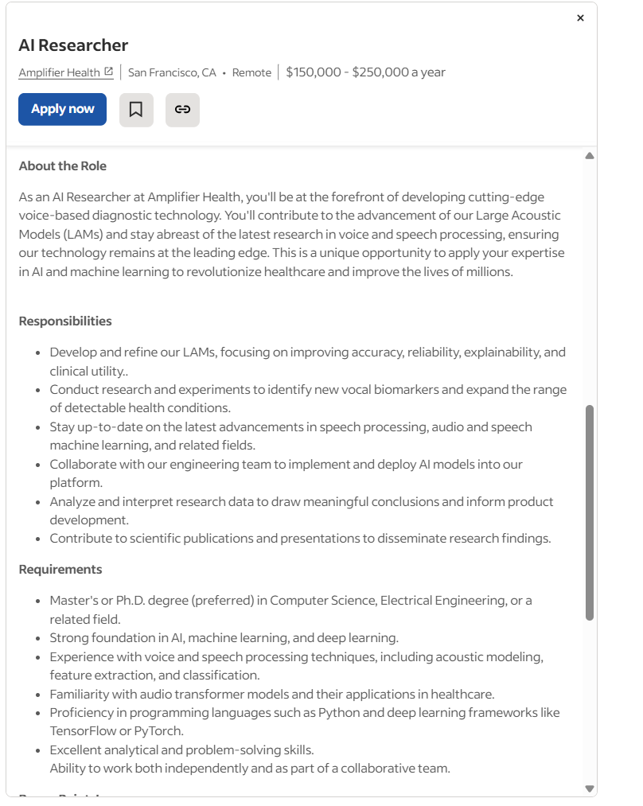
2. Data Science & AI Roles: AI Researcher
Role Summary:
Pushes the boundaries of AI and ML theory, often working on novel models, algorithms, or use cases.
Key Responsibilities:
Develop new learning architectures (e.g., transformers).
Publish papers, run experiments, and stay ahead of the curve.
Explore cutting-edge techniques (e.g., self-supervised learning, few-shot learning).
Why It’s Critical:
Enables innovation and differentiation, especially in R&D-heavy companies AI/GenAI work.
© All rights reserved for Dr. Ryan Ahmed @Stemplicity Inc.
https://www.indeed.com/jobs?q=ai+researcher&l=&from=searchOnDesktopSerp&vjk=a38bbe0988da5717

Slide 30
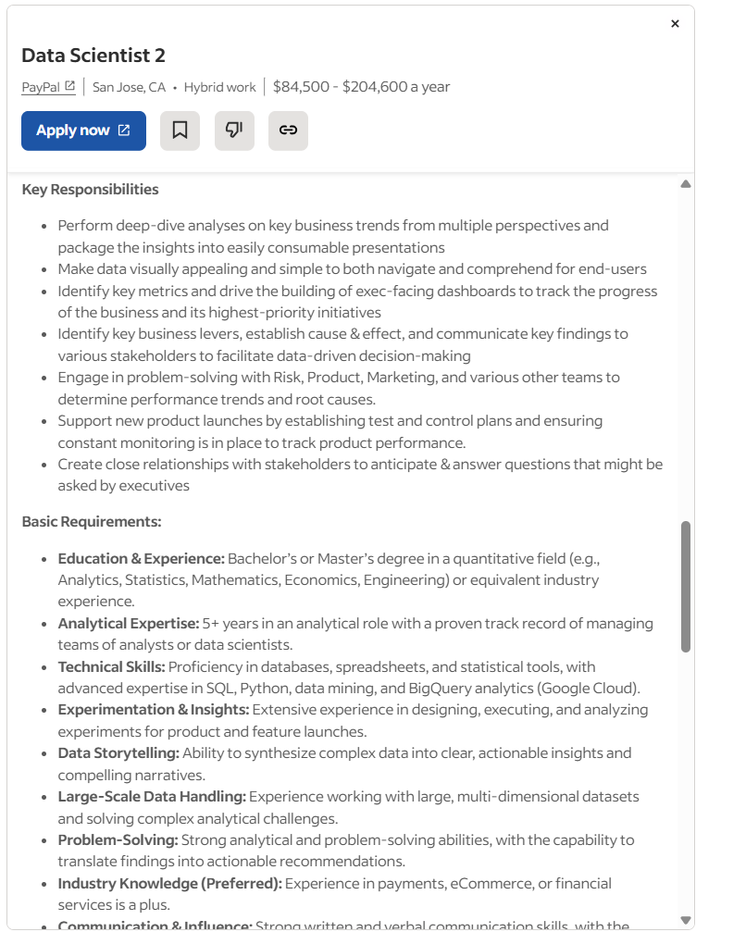
2. Data Science & AI Roles: Data Scientist
Role Summary:
Solves complex business problems using data. Uses statistical analysis and machine learning to derive insights and build predictive models.
Key Responsibilities:
Analyze structured and unstructured data.
Develop and test ML models.
Perform feature engineering.
Communicate insights to stakeholders.
Why It’s Critical:
Data scientists turn raw data into business value, guiding decisions and automating intelligent processes.
© All rights reserved for Dr. Ryan Ahmed @Stemplicity Inc.
https://www.indeed.com/jobs?q=data+scientist&l=&from=searchOnDesktopSerp%2Cwhatautocomplete%2CwhatautocompleteSourceStandard&vjk=28a94977251f9247

Slide 31
2. Data Science & AI Roles: Machine Learning Engineer
Role Summary:
Builds, tests, and deploys scalable machine learning pipelines. Often bridges the gap between data science and engineering.
Key Responsibilities:
Design ML pipelines for production.
Tune models for performance and scalability.
Integrate models into applications.
Collaborate with software and MLOps teams.
Why It’s Critical:
ML engineers make AI real by taking models out of notebooks and into production.
© All rights reserved for Dr. Ryan Ahmed @Stemplicity Inc.

Slide 32
2. Data Science & AI Roles: Responsible AI / Ethics Lead
Role Summary:
Ensures AI systems are ethical, fair, transparent, and inclusive. Evaluates models for unintended harm or bias.
Key Responsibilities:
Audit data and models for bias and discrimination.
Enforce fairness and explainability standards.
Ensure ethical practices in data labelling and use.
Why It’s Critical:
Helps prevent ethical issues, reputational damage, and regulatory violations in high-stakes domains.
© All rights reserved for Dr. Ryan Ahmed @Stemplicity Inc.

Slide 33
2. Data Science & AI Roles: UX Designer
Role Summary:
Designs intuitive interfaces for AI systems that enhance user trust, interpretability, and usability.
Key Responsibilities:
Create user journeys for interacting with AI outputs.
Simplify complex data/model results for end users.
Design feedback loops (e.g., for human-in-the-loop systems).
Why It’s Critical:
If users can’t understand or interact with the AI, they won’t use it, regardless of how powerful it is.
© All rights reserved for Dr. Ryan Ahmed @Stemplicity Inc.

Slide 34
3. Develpment and Operations Roles: Software Engineer
Role Summary:
Builds applications, APIs, and tools that integrate AI models into real-world products and user experiences.
Key Responsibilities:
Develop front-end and back-end systems.
Connect AI models to user interfaces and data sources.
Ensure code quality, scalability, and testing.
Work closely with ML engineers and UX designers.
Why It’s Critical: Even the best AI model is useless if it’s not integrated into a product. Software engineers turn models into usable tools.
© All rights reserved for Dr. Ryan Ahmed @Stemplicity Inc.

Slide 35
3. Develpment and Operations Roles: Solution Architect
Role Summary:
Designs the technical blueprint for how the AI system will be built, deployed, and maintained across the stack.
Key Responsibilities:
Define system architecture (data flow, storage, model interfaces).
Choose the right tools, platforms, and design patterns.
Ensure scalability, security, and interoperability.
Why It’s Critical:
Poor architecture means slow systems, high costs, and rework. A good architect sets the foundation for success.
© All rights reserved for Dr. Ryan Ahmed @Stemplicity Inc.

Slide 36
3. Develpment and Operations Roles: MLOps Architect
Role Summary:
MLOps engineers ensure that AI models don’t just live in notebooks; they make sure models are deployed, monitored, and continuously updated in production.
Key Responsibilities:
Automate model deployment (CI/CD pipelines).
Monitor model performance (accuracy, latency, drift).
Manage model versioning and rollback strategies.
Collaborate with data scientists and IT teams.
Why It’s Critical:
AI is not just about building models; it’s about running them reliably in the real world. MLOps ensures smooth, scalable operations.
© All rights reserved for Dr. Ryan Ahmed @Stemplicity Inc.

Slide 37
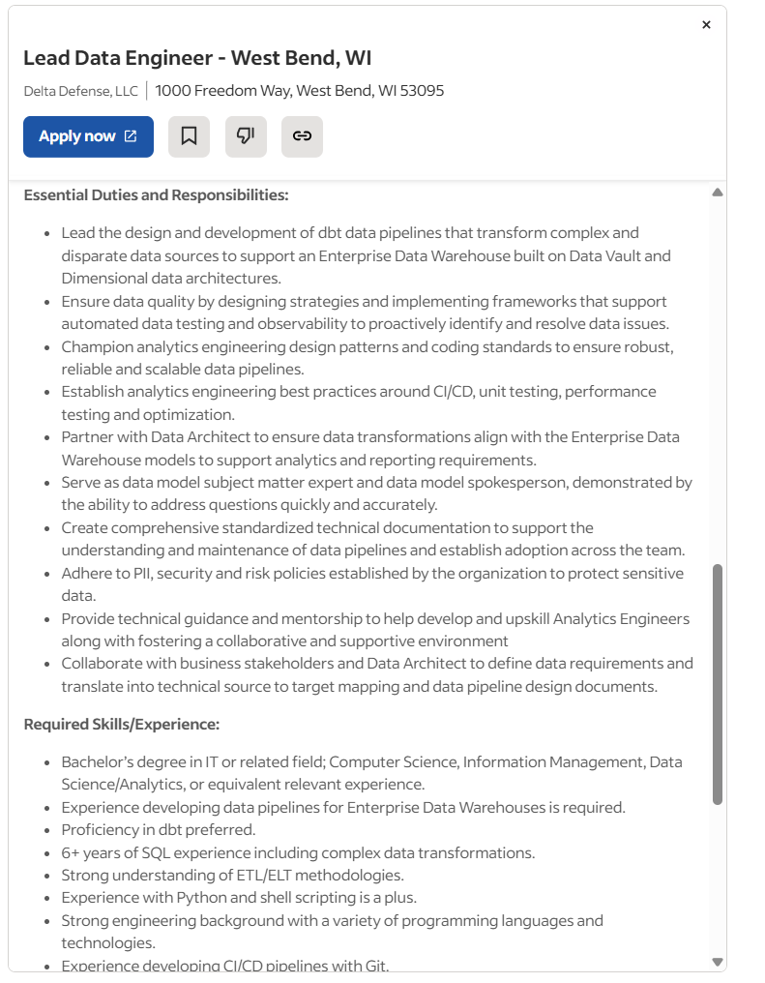
4. Data Engineering Roles: Data Engineer
Role Summary:
Builds and maintains the data pipelines that feed machine learning models and dashboards.
Key Responsibilities:
Design and implement ETL/ELT pipelines.
Clean, transform, and structure raw data.
Connect and integrate various data sources (APIs, databases, files).
Collaborate with data scientists to provide model-ready data.
Why It’s Critical:
No data = no AI. Data engineers are the backbone of the AI workflow, ensuring that clean, reliable data is always available.
© All rights reserved for Dr. Ryan Ahmed @Stemplicity Inc.
https://www.indeed.com/jobs?q=data+engineer&l=&from=searchOnDesktopSerp&vjk=c6e68d6152bab6fb&advn=7114382197951501

Slide 38
4. Data Engineering Roles: Data Architect
Role Summary:
Designs the overall data infrastructure and flow; ensuring that data is scalable, secure, and efficient to access.
Key Responsibilities:
Define data models, schemas, and architecture (e.g., lake vs warehouse).
Choose the right tools and platforms (Snowflake, BigQuery, etc.).
Ensure data storage is scalable and cost-effective.
Set best practices for data access, retention, and governance.
Why It’s Critical:
Without a sound structure, data becomes siloed, slow, or expensive to manage. The architect sets the foundation for all data-driven work.
© All rights reserved for Dr. Ryan Ahmed @Stemplicity Inc.

Slide 39
PRACTICE OPPORTUNITY

Slide 40
Practice Opportunity
Your company is launching an AI-powered customer support chatbot to reduce wait times and improve customer satisfaction. The chatbot should be able to understand customer inquiries, provide instant answers, and escalate to a human agent when needed. You are part of the project team, and your first task is to map responsibilities to the right stakeholders based on the roles in AI projects.
Below is a list of tasks involved in the project. Assign one appropriate role (from the summary table) to each task based on its key responsibilities.
Task | Assigned Role (Student to fill in)
Define the overall AI vision and align it with the business goals
Design and train the chatbot’s natural language processing model
Validate the customer complaint categories with real examples
Set up the cloud infrastructure to store and process chatbot data
Monitor the chatbot’s accuracy and response time in production
Ensure fairness and avoid bias in chatbot responses
Build the data pipelines to collect, clean, and store customer chats
Connect the chatbot to the company’s CRM system
Design how users interact with the chatbot and receive feedback
Coordinate the project timeline, sprints, and risk mitigation plans
© All rights reserved for Dr. Ryan Ahmed @Stemplicity Inc.

Slide 41
Practice Opportunity Solution
Task | Assigned Role
Define the overall AI vision and align it with the business goals | AI Product Manager
Design and train the chatbot’s natural language processing model | AI Researcher or Data Scientist
Validate the customer complaint categories with real examples | Industry Domain Expert
Set up the cloud infrastructure to store and process chatbot data | Solution Architect
Monitor the chatbot’s accuracy and response time in production | MLOps Architect
Ensure fairness and avoid bias in chatbot responses | Responsible AI / Ethics Lead
Build the data pipelines to collect, clean, and store customer chats | Data Engineer
Connect the chatbot to the company’s CRM system | Software Engineer
Design how users interact with the chatbot and receive feedback | UX Designer
Coordinate the project timeline, sprints, and risk mitigation plans | Project Manager
© All rights reserved for Dr. Ryan Ahmed @Stemplicity Inc.

Slide 42
WATERFALL Vs. AGILE DEVELOPMENT

Slide 43
Unique AI Projects Challenges
AI Projects offer unique challenges compared to traditional software projects.
Uncertain and evolving requirements:
AI project goals often shift based on data insights and model performance, making upfront planning difficult.
Data as a core dependency: Success heavily depends on data availability, quality, and relevance.
Non-deterministic outcomes: Unlike traditional software, AI models may never reach perfect accuracy, requiring tolerance for probabilistic results.
Complex team collaboration: AI projects require cross-functional teams (data scientists, engineers, domain experts), making coordination and communication more challenging.
© All rights reserved for Dr. Ryan Ahmed @Stemplicity Inc.

Slide 44
Waterfall Development
Traditional Waterfall development is a linear and sequential software development methodology where each phase must be completed before the next one begins.
This rigid approach allows minimal flexibility for changes once development starts.
Stakeholders don’t see the final product until all phases are complete, making it best for well-defined, predictable projects.
Example: Building a bridge. The entire design is finalized upfront, construction happens once, and testing is conducted only at the end.
Requirements
Design
Implement
Testing
Deployment
Maintenance
© All rights reserved for Dr. Ryan Ahmed @Stemplicity Inc.

Slide 45
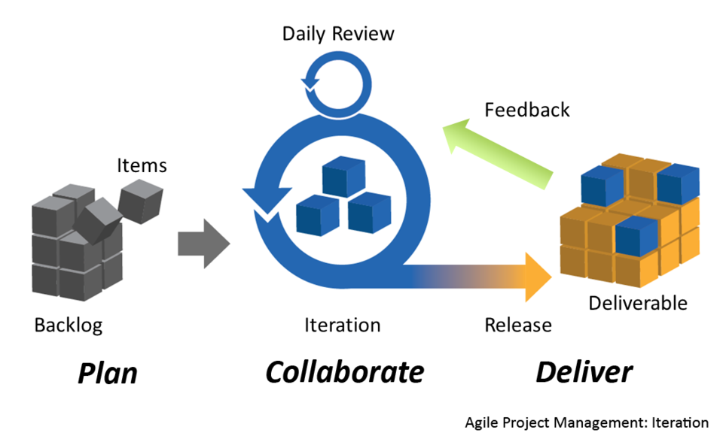
Agile Development
Agile development is a flexible, iterative approach to building products that focuses on collaboration, continuous feedback, and delivering small, working pieces frequently.
AI Projects are exploratory; the exact outcome can be uncertain, evolving with data/experimentation.
Work is broken into smaller, manageable increments delivered in short cycles, allowing for rapid feedback and adaptation.
© All rights reserved for Dr. Ryan Ahmed @Stemplicity Inc.
https://commons.wikimedia.org/wiki/File:Agile_Project_Management_by_Planbox.png

Slide 46
Waterfall Vs. Agile Development
Feature / Aspect | Agile Development | Waterfall Development
Approach | Iterative and incremental | Linear and sequential
Flexibility | Highly flexible; changes can be made at any stage | Inflexible; changes are difficult once a phase is completed
Project Phases | Phases (planning, design, development) are repeated in each iteration | Phases are distinct and completed one after the other
Customer Involvement | Continuous involvement and feedback | Limited involvement, mostly at the beginning and end
Testing | Ongoing throughout the development cycle | Done after the development phase
Delivery | Working product delivered in increments | Delivered at the end of the project
Risk Management | Lower risk due to frequent reassessment and delivery | Higher risk due to late testing and feedback
Team Collaboration | Strong emphasis on collaboration and self-organizing teams | Typically follows a top-down approach
Project Size & Complexity | Suitable for complex, evolving projects | Suitable for simple, well-defined projects
Examples of Use | Software startups, evolving products, dynamic requirements | Construction projects, manufacturing, regulated environments
© All rights reserved for Dr. Ryan Ahmed @Stemplicity Inc.

Slide 47
AI PROJECT MANAGEMENT FRAMEWORKS: CRISP-DM Vs. AGILE Vs. HYBRID

Slide 48
AI Project Management Frameworks
A. CRISP-DM
A classic data science methodology
Business understanding → Data understanding → Data preparation → Modeling → Evaluation → Deployment.
B. Agile for AI
Modified Agile practices (e.g., sprints, stand-ups) tailored for iterative experimentation, rapid prototyping, and model tuning. Very common in AI/ML teams.
C. Hybrid Approaches
Combining traditional project management with Agile and CRISP-DM to adapt to evolving data and model needs. Helps bridge business goals and technical execution.
© All rights reserved for Dr. Ryan Ahmed @Stemplicity Inc.

Slide 49
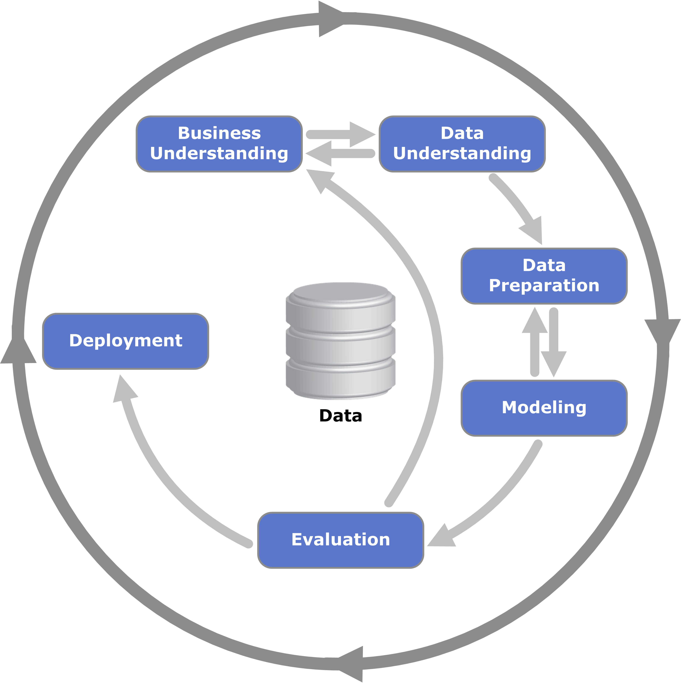
A. Crisp-DM Approach
CRISP-DM stands for Cross-Industry Standard Process for Data Mining. It’s one of the most widely used and foundational methodologies for managing data science and AI projects.
It provides a structured, six-phase process to guide teams from business understanding to deploying a working solution.
© All rights reserved for Dr. Ryan Ahmed @Stemplicity Inc.

Slide 50
A. Crisp-DM Phases
Phase | What Happens
1. Business Understanding | Define the project goals, success criteria, and business objectives. Understand the problem deeply.
2. Data Understanding | Collect initial data, explore it, and identify quality issues, patterns, or interesting features.
3. Data Preparation | Clean, transform, and engineer features. This step often takes the most time (up to 80%).
4. Modeling | Choose algorithms, build models, and experiment with parameters.
5. Evaluation | Assess how well the model meets business goals, not just accuracy. Ensure it solves a real problem.
6. Deployment | Deliver the model into production. May include documentation and monitoring.
© All rights reserved for Dr. Ryan Ahmed @Stemplicity Inc.

Slide 51
B. Agile for AI
Agile for AI is an adaptation of Agile project management tailored to the needs of AI/ML Projects.
It focuses on building AI solutions iteratively, collaborating across teams, and responding quickly to changes in data, performance, or business goals.
AI projects are uncertain by nature; you don’t always know what data will work, which model will perform best, or how users will react. Agile allows teams to explore, learn, and pivot quickly rather than following a rigid, linear plan.
Short, iterative sprints to develop, test, and refine models.
Continuous collaboration between data scientists, engineers, and business teams.
Fast feedback loops to validate models early and improve performance over time.
Flexibility to adjust the approach as new data or challenges emerge.
© All rights reserved for Dr. Ryan Ahmed @Stemplicity Inc.

Slide 52
C. Hybrid Approaches
A Hybrid Approach combines the structured phases of CRISP-DM with the flexibility and speed of Agile to manage AI projects more effectively.
It brings the best of both worlds: clear planning and documentation plus rapid, iterative development.
Structured Phases with Flexibility: Follows CRISP-DM’s stages (e.g., Business Understanding, Data Preparation, Modeling) but applies Agile sprints within each phase for quick iteration.
Milestones + Sprints: Project progress is tracked using clear milestones (good for reporting) while Agile sprints enable fast prototyping and experimentation in parallel.
Balanced Team Workflow: Supports both regulated environments (that need documentation and control) and dynamic teams (that need to test and adapt quickly).
© All rights reserved for Dr. Ryan Ahmed @Stemplicity Inc.
CRISP-DM
Hybrid
Agile

Slide 53
Comparison Summary
Aspect | CRISP-DM | Agile for AI | Hybrid Approach
Origin | Classic data science methodology | Software development (adapted for AI) | Blends CRISP-DM with Agile and traditional PM frameworks
Structure | Linear and phase-based | Iterative and cyclical | Structured milestones + iterative sprints within each phase
Focus | Comprehensive project phases | Rapid experimentation and delivery | Aligning long-term planning with short-term agility
Planning Style | Heavy up-front planning | Light planning, frequent adjustments | Initial high-level roadmap + flexible sprint planning
Team Interaction | Stakeholder involvement mostly at key milestones | Frequent collaboration (daily stand-ups, sprint reviews) | Regular sprint reviews + milestone-based stakeholder check-ins
Speed of Feedback | Slower (after full phase completion) | Fast (every sprint or 1–2 weeks) | Medium speed: sprint-based feedback but tied to business milestone reviews
Example Use | Structured projects with fixed scope | Projects needing rapid prototyping and tuning | Enterprise-level AI projects, regulated industries, or cross-functional efforts
Best For | Research, stable environments | Startups, evolving problem spaces | Large, strategic AI initiatives that need both control and flexibility
Risks Addressed | Misalignment with real-time changes | Lack of structure or documentation | Combines governance with adaptability
© All rights reserved for Dr. Ryan Ahmed @Stemplicity Inc.

Slide 54

Example
JP Morgan Chase wants to use AI to predict which customers are most likely to default on their loans. The objective is to improve risk management, automate loan approval decisions, and comply with regulatory standards.
Let’s explore the 3 approaches: CRISP-DM, Agile and Hybrid.
© All rights reserved for Dr. Ryan Ahmed @Stemplicity Inc.
https://www.flickr.com/photos/bensutherland/178395814/in/photostream/

Slide 55
CRISP-DM Approach
Business Understanding: Stakeholders want to reduce default-related losses and automate decisions for faster loan approvals.
Data Understanding: Explore data from past loan applicants, including demographics, employment history, credit scores, loan amounts, and repayment history.
Data Preparation: Clean missing values, encode categorical features (e.g., employment type), and create engineered features like debt-to-income ratio or credit utilization rate.
Modeling: Train classification models like XGBoost. Use cross-validation and grid search for hyperparameter tuning.
Evaluation: Use metrics like precision, recall, and F1-score. Evaluate fairness and bias (e.g., by gender or income level) using SHAP values and bias audits.
Deployment: Deploy the model through the bank’s loan approval portal. Monitor model drift and performance with batch scoring and dashboards.
© All rights reserved for Dr. Ryan Ahmed @Stemplicity Inc.

Slide 56
Agile for AI
Sprints:
Daily Stand-ups (15-mins): Data scientists, product owners, and compliance officers discuss blockers like missing data or fairness concerns.
Rapid Experimentation: Test multiple models, sampling strategies, and explainability tools in short cycles.
Week | Sprint Goals | Activities | Deliverables
Week 1 | Sprint 0: Planning & Setup | - Define problem and success metrics - Align with stakeholders - Set up data access & infrastructure | Product backlog, user stories, and sprint plan
Week 2 | Sprint 1: Data Exploration & Baseline | - Explore data - Identify data quality issues - Build and evaluate baseline model | Data profiling report, baseline model results
Week 3 | Sprint 2: Feature Engineering & Model Iteration | - Engineer features - Tune hyperparameters - Try multiple models | Improved model performance, Jupyter notebooks
Week 4 | Sprint 3: Evaluation & Explainability | - Test for fairness & bias - Add explainability (SHAP, LIME) - Validate with business team | Evaluation metrics, explainability report
Week 5 | Sprint 4: Deployment & Integration | - Prepare model for production - Set up model serving pipeline - Integrate with application | Model API, deployment script
Week 6 | Sprint 5: Monitoring & Feedback Loop | - Set up dashboards - Collect post-deployment feedback - Plan for retraining triggers | Monitoring dashboard, final report
© All rights reserved for Dr. Ryan Ahmed @Stemplicity Inc.

Slide 57
Hybrid Approach
Traditional PM Backbone: Define clear milestones (e.g., data readiness, model MVP, compliance approval, deployment) and Gantt timelines to satisfy senior management and regulators.
Agile Loops within Milestones: Use Agile cycles within each phase. For example, iterate on feature engineering while following CRISP-DM's structured flow.
Cross-functional Collaboration: The data science team works with risk officers, legal advisors, and DevOps teams to ensure technical feasibility, regulatory compliance (e.g., explainability under the Equal Credit Opportunity Act), and smooth deployment.
Post-deployment Governance: Set up model monitoring dashboards, bias tracking, and retraining triggers every quarter to keep models accurate and compliant.
© All rights reserved for Dr. Ryan Ahmed @Stemplicity Inc.

Slide 58
SCALED AGILE FRAMEWORK (SAFe)

Slide 59
Scaled Agile Framework (SAFe)
The SAFe (Scaled Agile Framework) is a structured methodology for scaling Agile, Lean, and DevOps practices across large enterprises.
SAFe is a structured framework designed to apply Agile at scale across multiple teams, departments, and even the entire enterprise.
https://framework.scaledagile.com/#essential
Alignment: Ensures all teams are working toward common strategic goals.
Faster Time-to-Market: Accelerates delivery of value through synchronized planning and execution.
Increased Productivity: Streamlines processes and improves team efficiency.
Improved Quality: Emphasizes built-in quality through continuous testing and integration.
Transparency: Provides visibility into work progress, dependencies, and risks.
Continuous Improvement: Encourages regular reflection and process enhancement.
Enhanced Collaboration: Promotes cross-functional teamwork across the organization.
Better Risk Management: Identifies and mitigates risks early through cadence and synchronization.
Customer-Centric Delivery: Focuses on delivering value that meets customer needs.
Scalability: Supports Agile implementation across large, complex enterprise environments.
© All rights reserved for Dr. Ryan Ahmed @Stemplicity Inc.

Slide 60
RISK MANAGEMENT IN AI PROJECTS

Slide 61
Risk Management in AI Projects: Navigating the Unknowns
AI projects come with unique categories of risks (e.g.: data quality, model bias, ethical concerns, and regulatory compliance) that require thoughtful planning and continuous oversight.
Effective AI project management should balance the open-ended, iterative nature of data science with the structured, goal-oriented discipline of traditional project execution.
Risk Management
© All rights reserved for Dr. Ryan Ahmed @Stemplicity Inc.
Data Issues
Model Bias
Integration Hurdles
…
…

Slide 62
Common AI Project Risks & Mitigations
Category | Issue | Mitigation
Data Risks | Poor quality, insufficient quantity, inherent biases, privacy concerns. | Thorough data assessment early, data governance, ethical data sourcing, data augmentation strategies, anonymization.
Technical Feasibility Risks | Model doesn’t achieve required accuracy, high computational costs, complex integration. | Start with a Proof-of-Concept, set realistic expectations, explore multiple algorithms, plan for scalability.
Stakeholder Alignment Risks | Misunderstanding of business problem, changing expectations, lack of buy-in. | Continuous communication, involve stakeholders in evaluation, clearly define success metrics, ensure executive sponsorship.
Operational & Deployment Risks | Difficult implementation, latency, scalability, model drift post-deployment, security vulnerabilities. | Implement IT/DevOps/MLOps early, design for production, plan for monitoring and retraining.
Ethical & Compliance Risks | Lack of fairness, bias, lack of transparency, regulatory non-compliance. | Establish ethical guidelines, conduct bias audits, ensure explainability where needed, consult legal/compliance teams.
© All rights reserved for Dr. Ryan Ahmed @Stemplicity Inc.

Slide 63
KEY INGREDIENTS FOR AI PROJECT SUCCESS

Slide 64
AI Success Equation
AI success = technology × people × alignment
© All rights reserved for Dr. Ryan Ahmed @Stemplicity Inc.

Slide 65
Key Success Ingredients in AI Projects
Clear Business Vision & Value Alignment: The "Why." AI must solve a real business problem and deliver measurable value.
Data Quality, Availability & Governance: Data is the lifeblood. A robust data strategy is non-negotiable.
Realistic Expectations & Iterative Progress: AI is not magic. Start small, iterate, and manage expectations.
Skilled Multidisciplinary Team & Strong Leadership: The "Who." Diverse expertise is crucial.
Effective Stakeholder Management & Communication: Keeping everyone informed and aligned.
Robust MLOps & Deployment Strategy: Moving from prototype to production reliably and scalably.
Ethical Considerations & Responsible AI: Building trust and mitigating societal risks
© All rights reserved for Dr. Ryan Ahmed @Stemplicity Inc.

Slide 66
AI PROJECT BUDGETING

Slide 67
AI Projects Budgeting
AI projects are complex and require careful financial planning. Many initiatives fail not due to poor algorithms but due to mismanaged budgets, unanticipated costs, or poor alignment with business goals.
Scoping & Planning:
Stakeholder workshops, consultant fees, feasibility studies
Data Strategy :
Data acquisition, cleaning, labeling, storage
Model Development:
Cloud compute (GPUs, TPUs), ML engineers, ML tools
Experimentation & Validation:
MLOps tools, test datasets, model evaluation
Deployment & Integration:
API hosting, backend integration, cloud DevOps
Monitoring & Maintenance:
Logging, retraining cycles, system uptime, support
© All rights reserved for Dr. Ryan Ahmed @Stemplicity Inc.

Slide 68
Key Cost Categories
Infrastructure: Cloud (AWS, Azure, GCP), storage, bandwidth.
Human Resources: Engineers, data scientists, PMs, analysts.
Software/Tools: SaaS platforms, annotation tools, IDEs.
Data: Licenses, external datasets, labeling services.
Ongoing Operations: Maintenance, security, updates.
© All rights reserved for Dr. Ryan Ahmed @Stemplicity Inc.

Slide 69
Budget Example
Category | Subcategories / Examples | Adjusted Cost Range
1. Infrastructure | GPUs, servers, local/cloud storage | $4,000 – $30,000 (initial setup)
2. Software & Tools | Cloud platforms, AI frameworks, dev tools | $500 – $7,000 + $150–$1,200/month
3. Talent / Human Capital | Data scientists, ML engineers, AI specialists | $100K – $140K/year per role (Location Dependent)
4. Training & Development | Online courses, workshops, team upskilling | $300 – $3,000
5. Data Acquisition | Licensed datasets, data vendors, collection software | $1,500 – $45,000 + $600–$4,500/month
6. Data Management | Cleaning, labeling, storage, security systems | $1,200 – $18,000 + $150–$2,200/month
7. Operations | Continuous data intake, model retraining, testing | $600 – $4,800/month
8. Maintenance | Server upkeep, cloud usage fees, cybersecurity tools | $750 – $9,500/month
9. Integration Costs | Custom APIs, system integration, user training | $6,000 – $45,000
10. Hidden/Unexpected | Advanced feature engineering, model revisions, legal/ethics review | $3,000 – $28,000
11. Total Project Range | Pilot to enterprise-level deployment | $15,000 – $450,000+
© All rights reserved for Dr. Ryan Ahmed @Stemplicity Inc.

Slide 70
PRACTICE OPPORTUNITY

Slide 71
Practice Opportunity
You are part of a consulting team advising a mid-size tech company interested in building a generative AI system. Your client wants to understand what it would take to train a model like GPT-3 or GPT-4 from scratch (or fine-tune one at scale) and whether it’s financially realistic.
Select a Frontier AI Model to Research (Choose One): GPT-3, GPT-4, Gemini 1.5, or Claude 3 (Anthropic)
Aspect | Your Research Findings
Estimated total training cost | What are the publicly available figures or best estimates?
Infrastructure & compute cost | What kind of chips (e.g., A100, V100, H100)? How many? Any cloud usage?
Talent & research personnel | What teams are typically involved (e.g., researchers, MLOps, engineers)?
Energy consumption & location | Where was it trained? What’s the estimated power or energy footprint?
Ongoing operational cost | What is the estimated daily or monthly cost of inference/serving?
© All rights reserved for Dr. Ryan Ahmed @Stemplicity Inc.

Slide 72
Practice Opportunity Solution
Category | Estimated Cost | Details & Notes
Total Training Cost | $63M – $100M+ | Includes compute, staff, infrastructure, and energy. Sam Altman confirmed >$100M.
GPU Hardware (CapEx) | ~$800M (purchase) | Based on NVIDIA A100 clusters (tens of thousands of GPUs); often amortized.
Amortized Hardware Cost | ~$40M | Spread out over multiple projects or usage cycles.
Compute Cost (Training) | ~$63M – $78M | For model training using cloud or in-house clusters.
Staff & Research | ~30–40% of total training cost | Includes ML engineers, researchers, alignment teams, MLOps, etc.
Interconnect & Servers | ~15–22% of total training cost | Includes high-speed networking (e.g., NVLink) and non-GPU server infrastructure.
Cluster Interconnect | ~9–13% | Covers networking between compute nodes.
Energy Consumption | ~2–6% | Power for running clusters; varies by region and efficiency.
Water Use (Cooling) | ~0.5 liters/query | For data center cooling; significant for inference at scale.
Inference (Daily Ops) | ~$700K/day | Ongoing cost to serve ChatGPT to users globally.
Cost Per Query | ~$0.0036/token (≈0.36¢/query) | Based on OpenAI’s serving scale and infrastructure.
© All rights reserved for Dr. Ryan Ahmed @Stemplicity Inc.
https://www.forbes.com/sites/katharinabuchholz/2024/08/23/the-extreme-cost-of-training-ai-models/

Slide 73

Summary
Start with a clear vision, business value, and feasibility check; define a focused MVP to manage scope.
Use SMART goals across model (e.g., accuracy), system (e.g., latency), and business (e.g., retention) levels.
Assign key roles: product managers, data scientists, ML engineers, MLOps, and domain experts.
Prefer Agile or Hybrid methods for flexibility; use SAFe to scale across teams.
Budget carefully and plan for risks like data quality, bias, and compliance.
© All rights reserved for Dr. Ryan Ahmed @Stemplicity Inc.

Slide 74
Thank you!

